Slide 1
Lecture 6: Introduction to Probability
Dr. A. Ramesh
Department of Management Studies

Slide 2
Lecture objectives
Comprehend the different ways of assigning probability
Understand and apply marginal, union, joint, and conditional probabilities
Solve problems using the laws of probability including the laws of addition, multiplication and conditional probability
Revise probabilities using Bayes’ rule

Slide 3
Probability
Probability is the numerical measure of the likelihood that an event will occur.
The probability of any event must be between 0 and 1, inclusively
0 ≤ P(A) ≤ 1 for any event A.
The sum of the probabilities of all mutually exclusive and collectively exhaustive events is 1.
– P(A) + P(B) + P(C) = 1
A, B, and C are mutually exclusive and collectively exhaustive

Slide 4
Range of Probability
1
Certain
.5
0
Impossible

Slide 5
Methods of Assigning Probabilities
Classical method of assigning probability (rules and laws)
Relative frequency of occurrence (cumulated historical data)
Subjective Probability (personal intuition or reasoning)

Slide 6
Classical Probability
Number of outcomes leading to the event divided by the total number of outcomes possible
Each outcome is equally likely
Determined a priori -- before performing the experiment
Applicable to games of chance
Objective -- everyone correctly using the method assigns an identical probability

Slide 7
P( E ) = ^{ne}
Classical Probability
N
Where:
N = total number of outcomes
n_{e} = number of outcomes in E

Slide 8
Relative Frequency Probability
Based on historical data
Computed after performing the experiment
Number of times an event occurred divided by the number of trials
Objective -- everyone correctly using the method assigns an identical probability

Slide 9
Relative Frequency Probability
P(E) = ^{ne}
N
Where:
N = total number of trials
n_{e} = number of outcome producing E

Slide 10
Subjective Probability
Comes from a person’s intuition or reasoning
Subjective -- different individuals may (correctly) assign different numeric probabilities to the same event
Degree of belief
Useful for unique (single-trial) experiments
New product introduction
Initial public offering of common stock
Site selection decisions
Sporting events

Slide 11
Probability - Terminology
Experiment
Event
Elementary Events
Sample Space
Unions and Intersections
Mutually Exclusive Events
Independent Events
Collectively Exhaustive Events
Complementary Events

Slide 12
Experiment, Trial, Elementary Event, Event
Experiment: a process that produces outcomes
More than one possible outcome
Only one outcome per trial
Trial: one repetition of the process
Elementary Event: cannot be decomposed or broken down into other events
Event: an outcome of an experiment
may be an elementary event, or
may be an aggregate of elementary events
usually represented by an uppercase letter, e.g., A, E1

Slide 13
An Example Experiment
Experiment: randomly select, without replacement, two families from the residents of Tiny Town
Elementary Event: the sample includes families A and C
Event: each family in the sample
has children in the household
Event: the sample families own a total of four automobiles
Tiny Town Population
Family | Children in Household | Number of Automobiles
A | Yes | 3
B | Yes | 2
C | No | 1
D | Yes | 2

Slide 14
Sample Space
The set of all elementary events for an experiment
Methods for describing a sample space
roster or listing
tree diagram
set builder notation
Venn diagram

Slide 15
Sample Space: Roster Example
Experiment: randomly select, without replacement, two families from the residents of Tiny Town
Each ordered pair in the sample space is an elementary event, for example
-- (D,C)
Family | Children in Household | Number of Automobiles
A | Yes | 3
B | Yes | 2
C | No | 1
D | Yes | 2
Listing of Sample Space
(A,B), (A,C), (A,D),
(B,A), (B,C), (B,D),
(C,A), (C,B), (C,D),
(D,A), (D,B), (D,C)

Slide 16
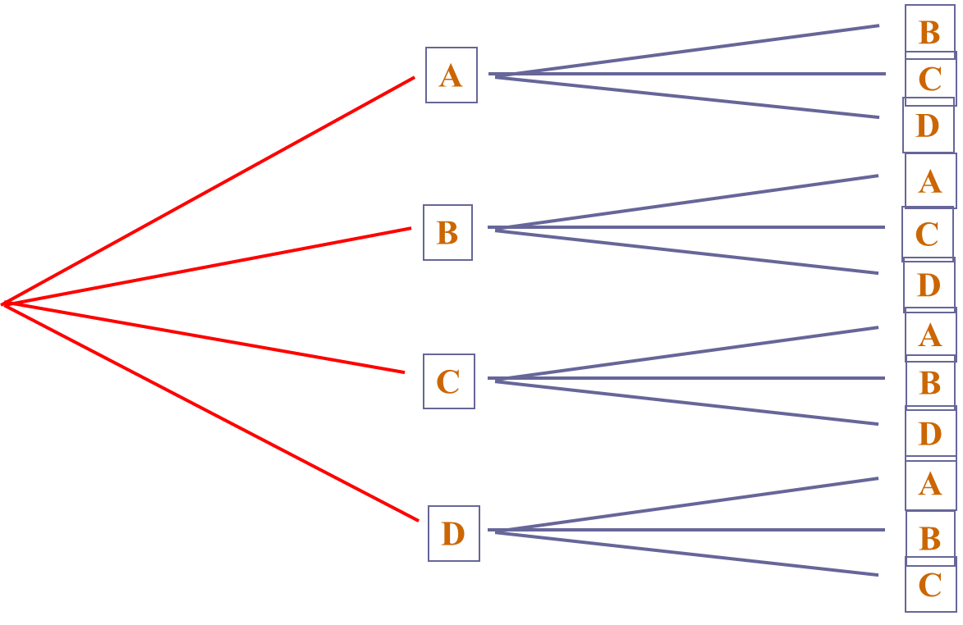
Sample Space: Tree Diagram for Random Sample of Two Families

Slide 17
Sample Space: Set Notation for Random Sample of Two Families
S = {(x,y) | x is the family selected on the first draw, and y is the family selected on the second draw}
Concise description of large sample spaces

Slide 18
Sample Space
Useful for discussion of general principles and concepts
Listing of Sample Space
Venn Diagram
(A,B), (A,C), (A,D),
(B,A), (B,C), (B,D),
(C,A), (C,B), (C,D),
(D,A), (D,B), (D,C)

Slide 19


Union of Sets
The union of two sets contains an instance of each element of the two sets.
X = {1,4,7,9}
Y = {2,3,4,5,6}
X ∪ Y = {1,2,3,4,5,6,7,9}
X
Y
C = { IBM , DEC, Apple}
F = { Apple, Grape, Lime}
C ∪ F = { IBM , DEC, Apple, Grape, Lime}

Slide 20
Intersection of Sets
The intersection of two sets contains only those element common to the
two sets.
X = {1,4,7,9}
Y = {2,3,4,5,6}
X ∩ Y = {4}
X
Y
C = { IBM , DEC, Apple} F = { Apple, Grape, Lime} C ∩ F = { Apple}

Slide 21
Mutually Exclusive Events
Events with no common outcomes
Occurrence of one event precludes the occurrence of the other event
C = {IBM , DEC, Apple}
F = {Grape, Lime} C ∩ F = { }
X Y
X = {1,7,9}
Y = {2,3,4,5,6}
X ∩ Y = { }
P( X ∩ Y ) = 0

Slide 22
Independent Events
Occurrence of one event does not affect the occurrence or nonoccurrence of the other event
The conditional probability of X given Y is equal to the marginal probability of X.
The conditional probability of Y given X is equal to the marginal probability of Y.
P( X|Y ) = P( X) and P(Y| X) = P(Y )

Slide 23
Collectively Exhaustive Events
Contains all elementary events for an experiment
E₁
E₂
E₃
Sample Space with three
collectively exhaustive events

Slide 24

Complementary Events
All elementary events not in the event ‘A’ are in its complementary event.
Sample Space
P(Sample Space ) = 1
A A′
P( A′) = 1− P( A)

Slide 25
Counting the Possibilities
mn Rule
Sampling from a Population with Replacement
Combinations: Sampling from a Population without Replacement

Slide 26
mn Rule
If an operation can be done m ways and a second operation can be done n ways, then there are mn ways for the two operations to occur in order.
This rule is easily extend to k stages, with a number of ways equal to n₁.n₂.n₃..n_{k}
Example: Toss two coins . The total umber of simple events is 2 x 2 =4

Slide 27
Sampling from a Population with Replacement
A tray contains 1,000 individual tax returns. If 3 returns are randomly selected with replacement from the tray, how many possible samples are there?
(N)^{n} = (1,000)³ = 1,000,000,000

Slide 28
Combinations
A tray contains 1,000 individual tax returns. If 3 returns are randomly selected without replacement from the tray, how many possible samples are there?
⎛ N ⎞ ₌
N!
n!(N − n)!
1000!
3!(1000 − 3)!
⎜ _{n} ⎟
=
= 166,167,000
⎝ ⎠

Slide 29







Four Types of Probability
Marginal
P( X)
The probability
of X occurring
Union | Joint | Conditional
P( X ∪ Y ) The probability of X or Y occurring X Y | P( X ∩ Y ) The probability of X and Y occurring X Y | P( X|Y ) The probability of X occurring given that Y has occurred Y
X

Slide 30




General Law of Addition
P( X ∪ Y ) = P( X) + P(Y ) − P( X ∩ Y )
X Y

Slide 31

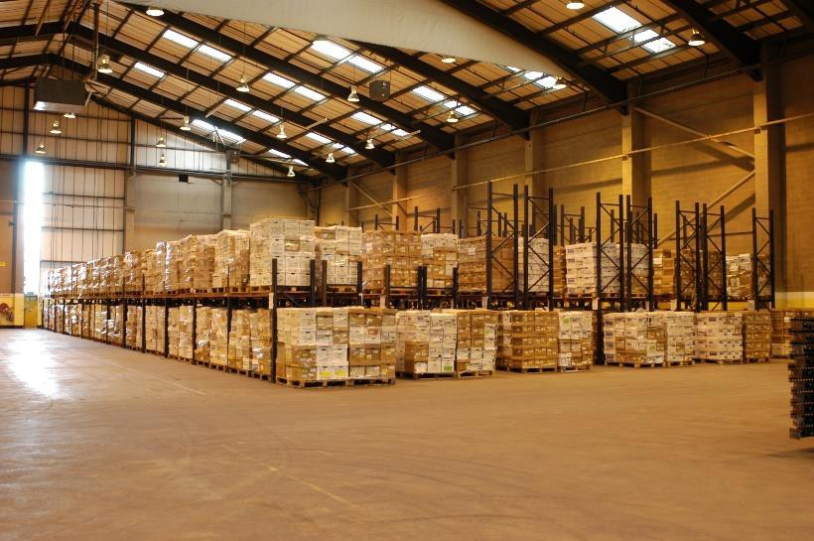
Design for improving productivity?

Slide 32
Problem
A company conducted a survey for the American Society of Interior Designers in which workers were asked which changes in office design would increase productivity.
Respondents were allowed to answer more than one type of design change.
Reducing noise would increase productivity | 70 %
More storage space would increase productivity | 67 %

Slide 33
Problem
If one of the survey respondents was randomly selected and asked what office design changes would increase worker productivity,
– what is the probability that this person would select reducing noise or
more storage space?

Slide 34

Solution
Let N represent the event “reducing noise.”
Let S represent the event “more storage/ filing space.”
The probability of a person responding with N or S can be symbolized statistically as a union probability by using the law of addition.

Slide 35




General Law of Addition -- Example
P( N ∪ S) = P( N ) + P(S) − P( N ∩ S)
N
S
P( N ) =.70
P(S ) =.67
P( N ∩ S ) =.56
P( N ∪ S ) =.70+.67−.56
= 0.81
.70
.56
.67

Slide 36
Office Design Problem Probability Matrix
Increase Storage Space
 |  | Yes | No | Total
 | Yes | .56 | .14 | .70
 | No | .11 | .19 | .30
Total |  | .67 | .33 | 1.00
Noise Reduction

Slide 37
Joint Probability Using a Contingency Table
Event
Total
Event
B₁
B₂
A₁
P(A₁ and B₁)
P(A₁ and B₂)
P(A₁)
A₂
P(A₂ and B₁)
P(A₂ and B₂)
P(A₂)
Total
P(B₁)
P(B₂)
1
Joint Probabilities
Marginal (Simple) Probabilities

Slide 38

Office Design Problem - Probability Matrix
Increase Storage Space
 |  | Yes | No | Total
 | Yes | .56 | .14 | .70
 | No | .11 | .19 | .30
Total |  | .67 | .33 | 1.00
Noise Reduction
P( N ∪ S ) = P( N ) + P(S ) − P( N ∩ S )
=.70+.67−.56
=.81

Slide 39
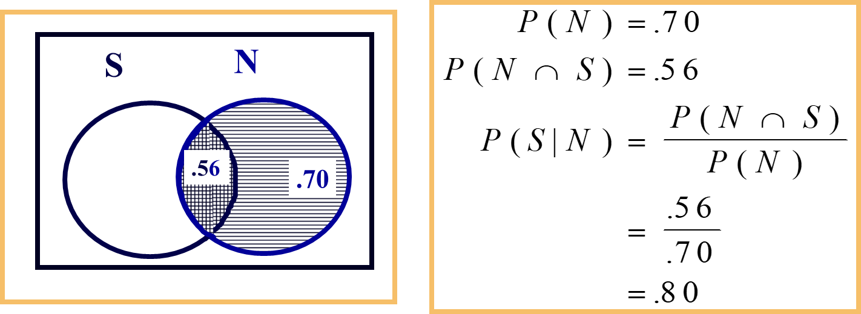
Law of Conditional Probability

Slide 40
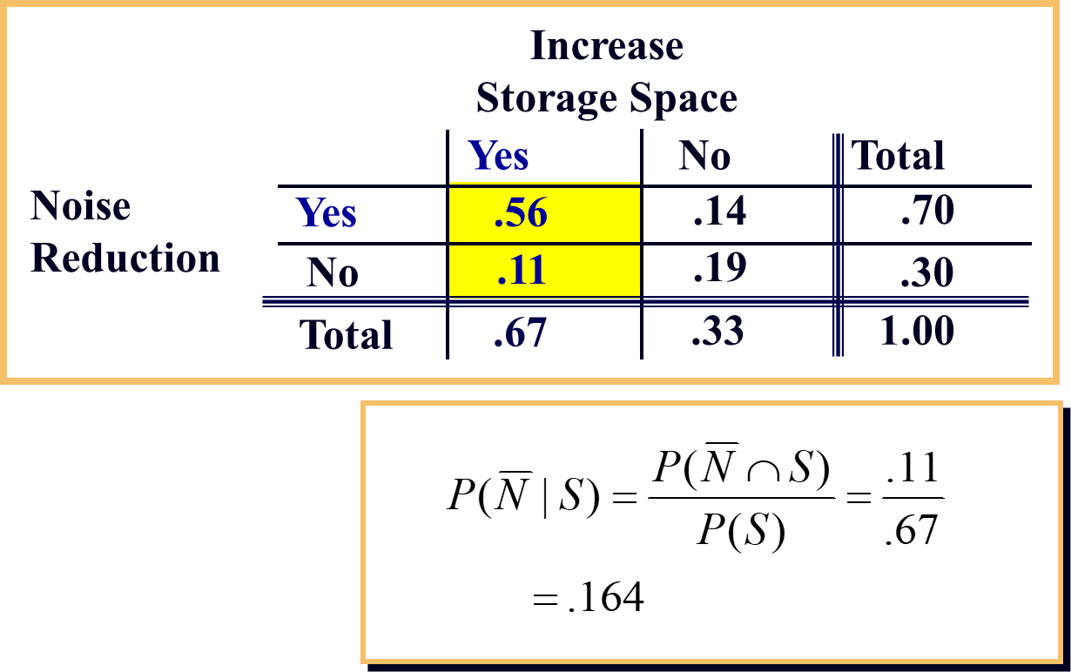
Office Design Problem

Slide 41
Problem
A company data reveal that 155 employees worked one of four types of positions.
Shown here again is the raw values matrix (also called a contingency table) with the frequency counts for each category and for subtotals and totals containing a breakdown of these employees by type of position and by sex.

Slide 42
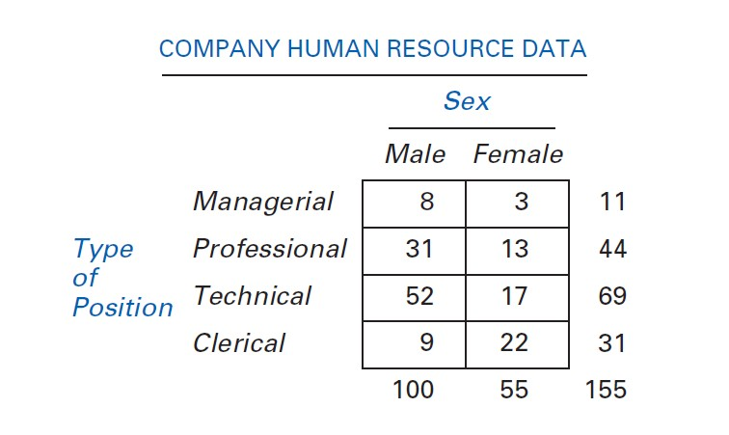
Contingency Table

Slide 43


Solution
If an employee of the company is selected randomly, what is the probability that the employee is female or a professional worker?

Slide 44
Problem
Shown here are the raw values matrix and corresponding probability matrix for the results of a national survey of 200 executives who were asked to identify the geographic locale of their company and their company’s industry type.
The executives were only allowed to select one locale and one industry type.

